Slide 1
Bagging

Slide 3
Outline
Review of Decision Trees
Bagging
Out of Bag Error (OOB)
Variable Importance

Slide 4
Outline
Review of Decision Trees
Bagging
Out of Bag Error (OOB)
Variable Importance

Slide 5
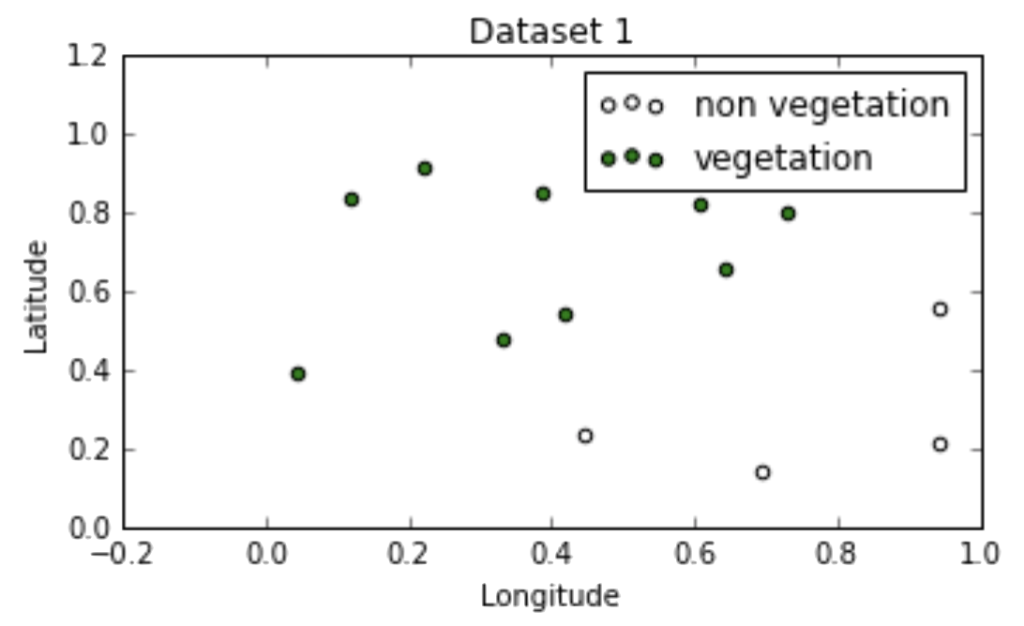
Geometry of Data
Question: Can you guess the equation that defines the decision boundary below?
Notes:
Could be a poll

Slide 6
Geometry of Data
Question: Can you guess the equation that defines the decision boundary below?
$$−0.8x_{1}+x_{2}=0 ⟹x_{2}=0.8x_{1}⇒ Latitude=0.8 Lon$$
Notes:
Could be a poll

Slide 7
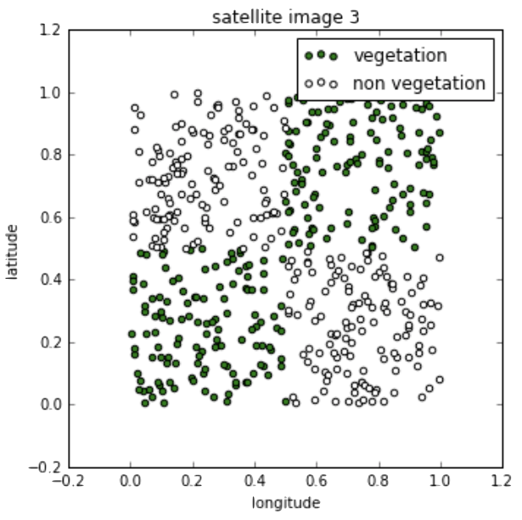
Geometry of Data
Complicate decision boundaries can not be explained with LogRegression.
Notes:
Could be a draw lines

Slide 8
Geometry of Data
But can be using Trees. Which one represents the first split of a decision tree?
Notes:
Could be a draw lines

Slide 9
Decision Trees
To learn a decision tree model, we take a greedy approach:
Start with a node containing all the data.
If stopping condition is not met:
Choose the ‘optimal’ predictor and threshold and divide the data in the node into two sets.
For each new node, repeat step 2.

Slide 10
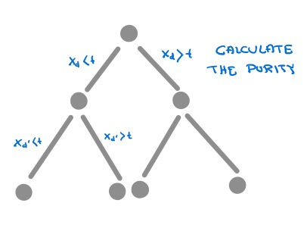
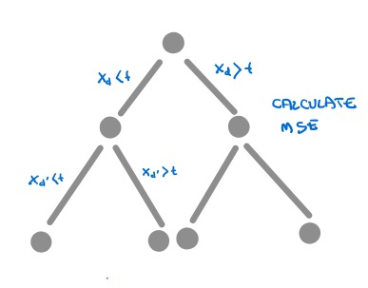
Decision Trees: Splitting Criteria
Splitting Criteria:
For classification, purity of the regions is a good indicator the performance of the model. Entropy as a splitting criterial minimizes the cross-entropy (greedy). Gini is also a splitting criteria.
For regression, we want to select a splitting criterion that promotes splits that improves the predictive accuracy of the model as measured by the MSE

Slide 11
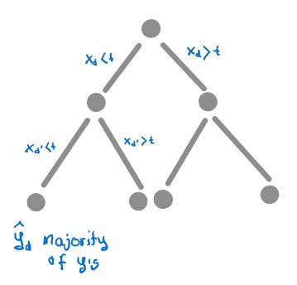
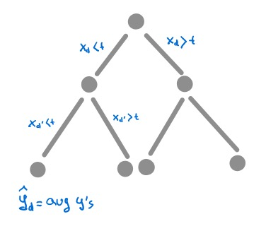
Decision Trees: Prediction
Prediction:
For classification, we label each region in the model with the label of the class to which the plurality of the points within the region belong.
For regression, we predict with the average of the output values of the training points contained in the region.

Slide 12
Stopping Conditions
The stopping condition is usually a maximum depth or a minimum MSE.
But others common simple stopping conditions:
Don’t split a region if all instances in the region belong to the same class.
Don’t split a region if the number of instances in the sub-region will fall below pre-defined threshold (min_samples_leaf).
Don’t split a region if the total number of leaves in the tree will exceed pre-defined threshold.
Don’t split if the gain in purity, information, reduction in entropy or MSE of splitting a region R into R₁ and R₂ is less than some pre-defined threshold.

Slide 13
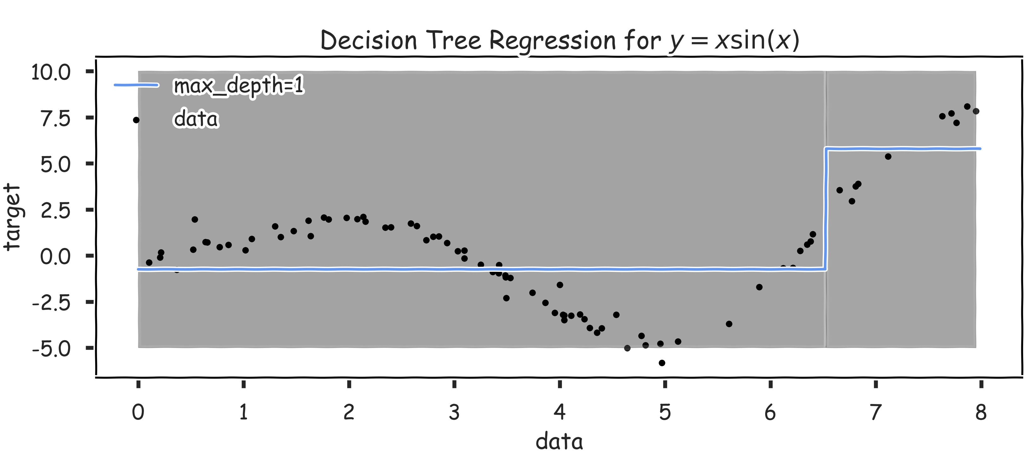
Regression Trees Prediction (grey scale represents MSE)

Slide 14
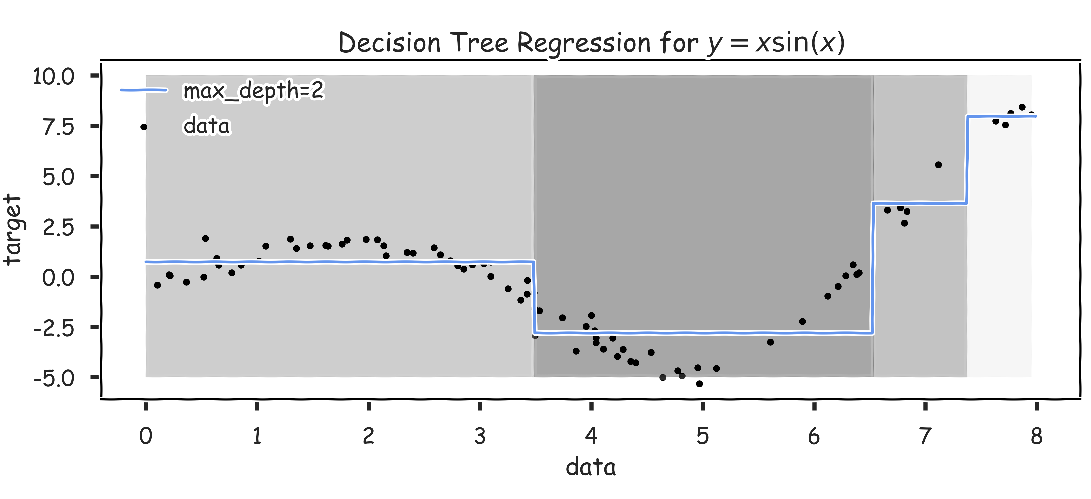
Regression Trees Prediction (grey scale represents MSE)

Slide 15
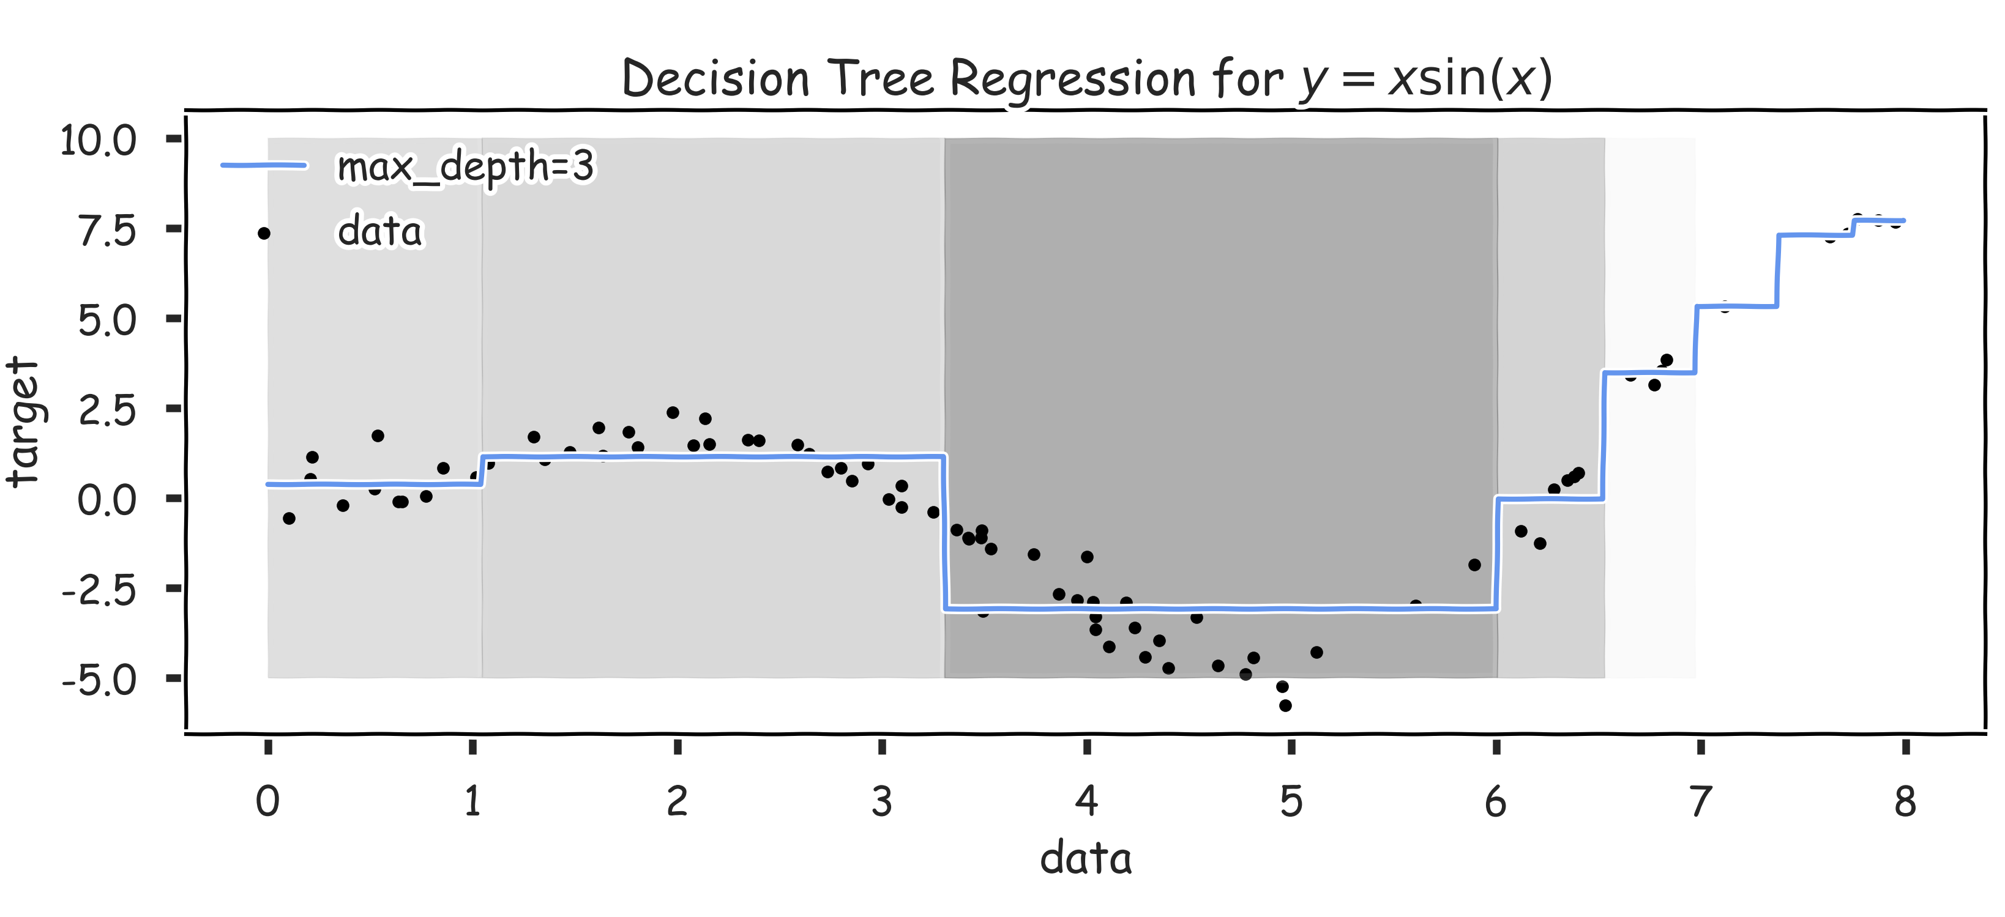
Regression Trees Prediction (grey scale represents MSE)

Slide 16
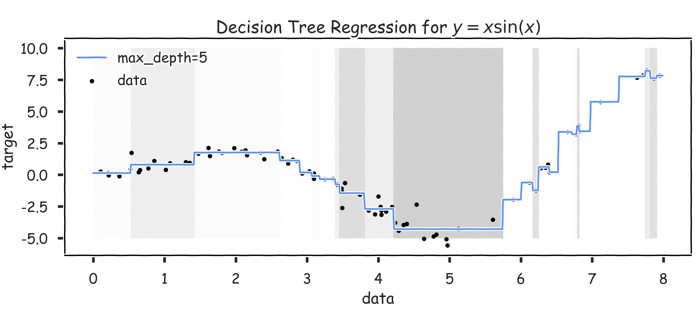
Regression Trees Prediction (grey scale represents MSE)

Slide 17
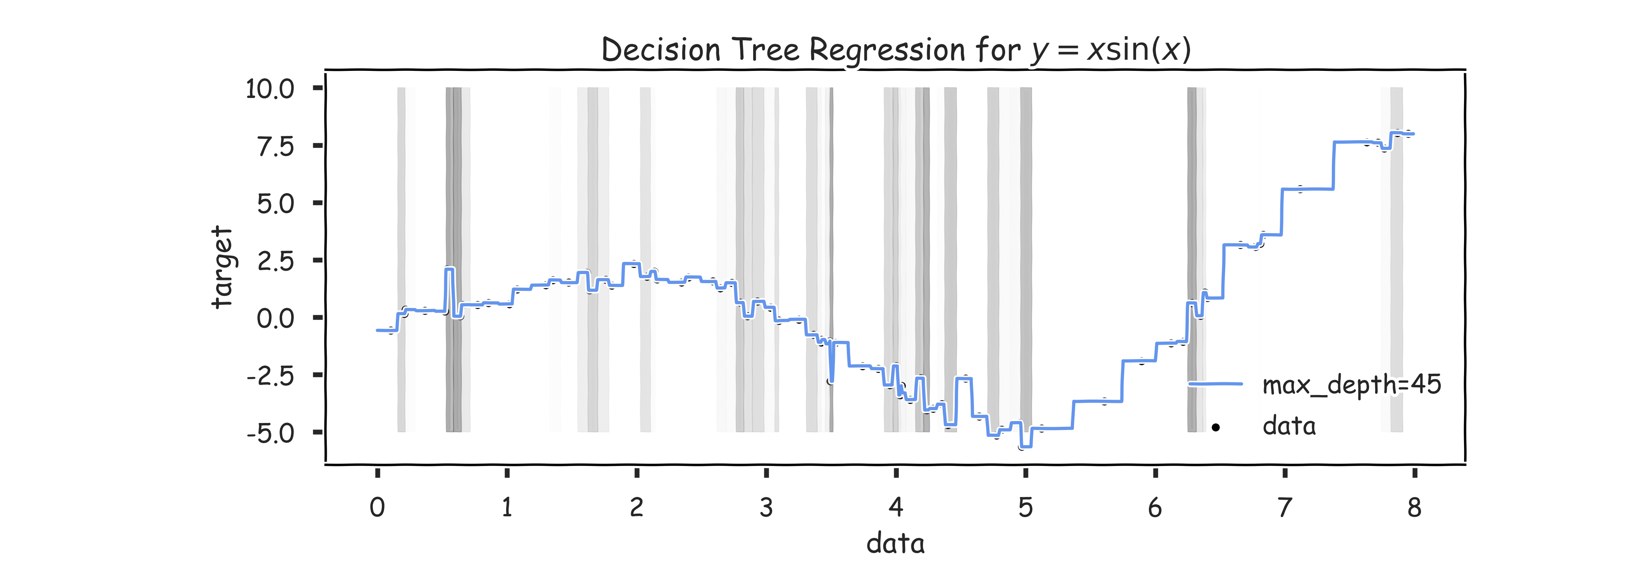
Regression Trees Prediction (grey scale represents MSE)

Slide 18
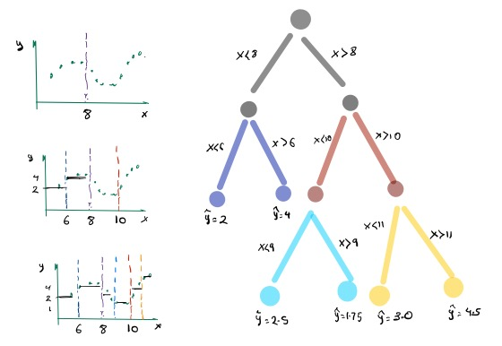

Slide 19
Overfitting
When tree is too shallow, it cannot divide the input data into enough regions, so the model underfits. When the tree is too deep it cuts the input space into too many regions and fit to the noise of the data -> overfits.

Slide 20
Overfitting
Avoid overfitting by pruning or limiting the depth of the tree and using CV.

Slide 21
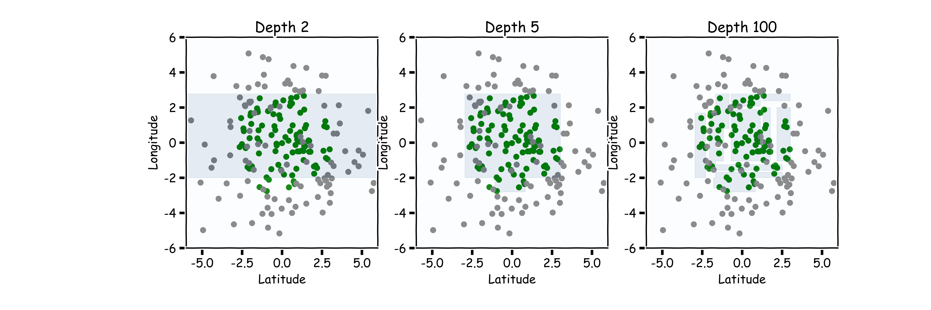
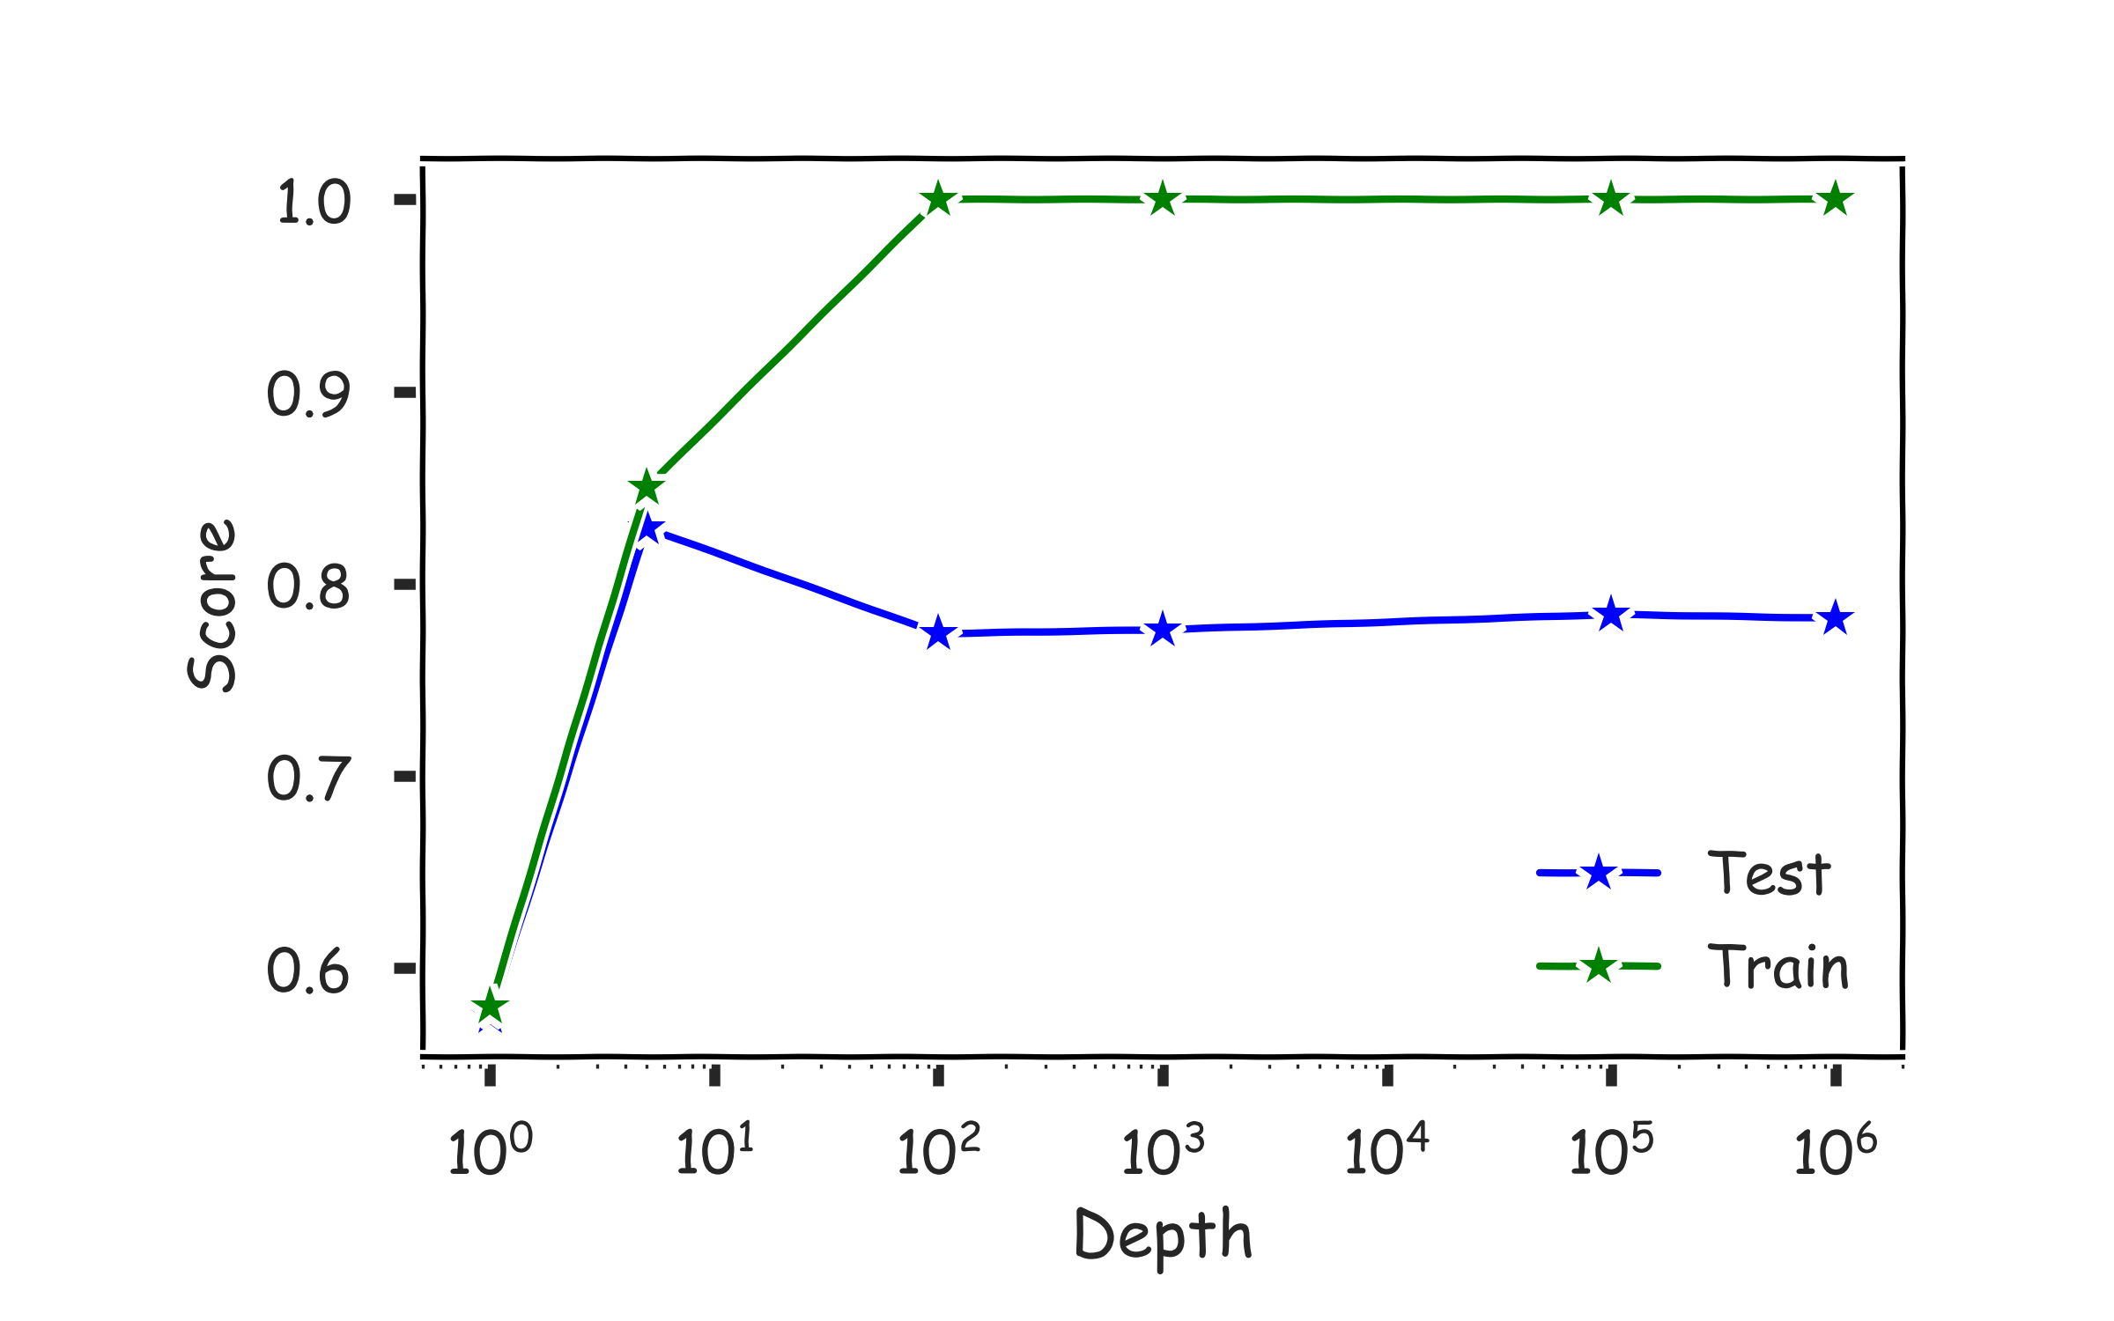
Reduce the variance: Depth of the tree
We’ve seen that large trees have high variance and are prone to overfitting.
Use train/validation or cross validation to estimate the best depth.

Slide 22
Limitations of Decision Tree Models
Decision trees models are highly interpretable and fast to train, using our greedy learning algorithm.

Slide 23
Limitations of Decision Tree Models
Decision trees models are highly interpretable and fast to train, using our greedy learning algorithm.
However, to capture a complex decision boundary (or approximate a complex function), we need to use a large tree (since each time we can only do axis-aligned splits).

Slide 24
Limitations of Decision Tree Models
Decision trees models are highly interpretable and fast to train, using our greedy learning algorithm.
However, to capture a complex decision boundary (or approximate a complex function), we need to use a large tree (since each time we can only do axis-aligned splits).
We’ve seen that large trees have high variance and are prone to overfitting.

Slide 25
Limitations of Decision Tree Models
Decision trees models are highly interpretable and fast to train, using our greedy learning algorithm.
However, to capture a complex decision boundary (or approximate a complex function), we need to use a large tree (since each time we can only do axis-aligned splits).
We’ve seen that large trees have high variance and are prone to overfitting.
For these reasons, in practice, decision tree models often underperform when compared with other classification or regression methods.

Slide 26
Outline
Review of Decision Trees
Bagging
Out of Bag Error (OOB)
Variable Importance

Slide 27
Bagging

Slide 28
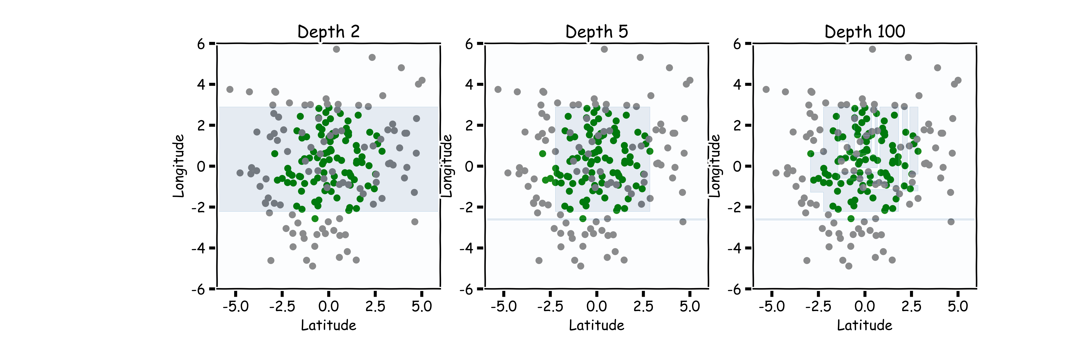
Bagging
My favorite reality: magic realism -> bootstrap

Slide 29
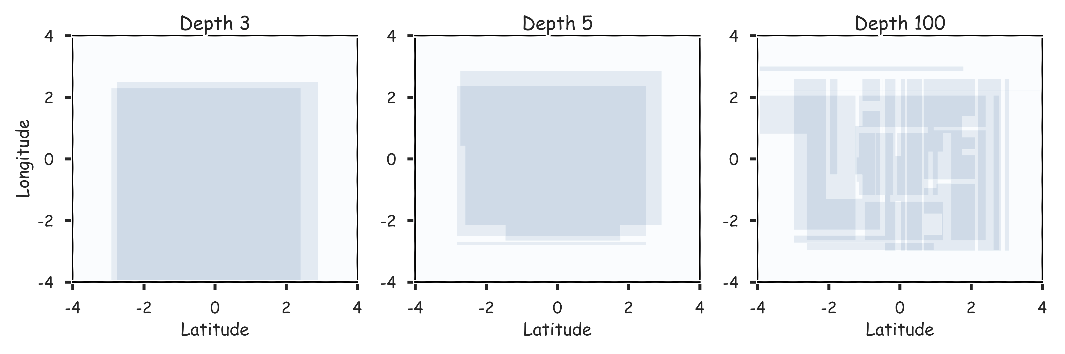
Combine them? 2 magic realisms

Slide 30
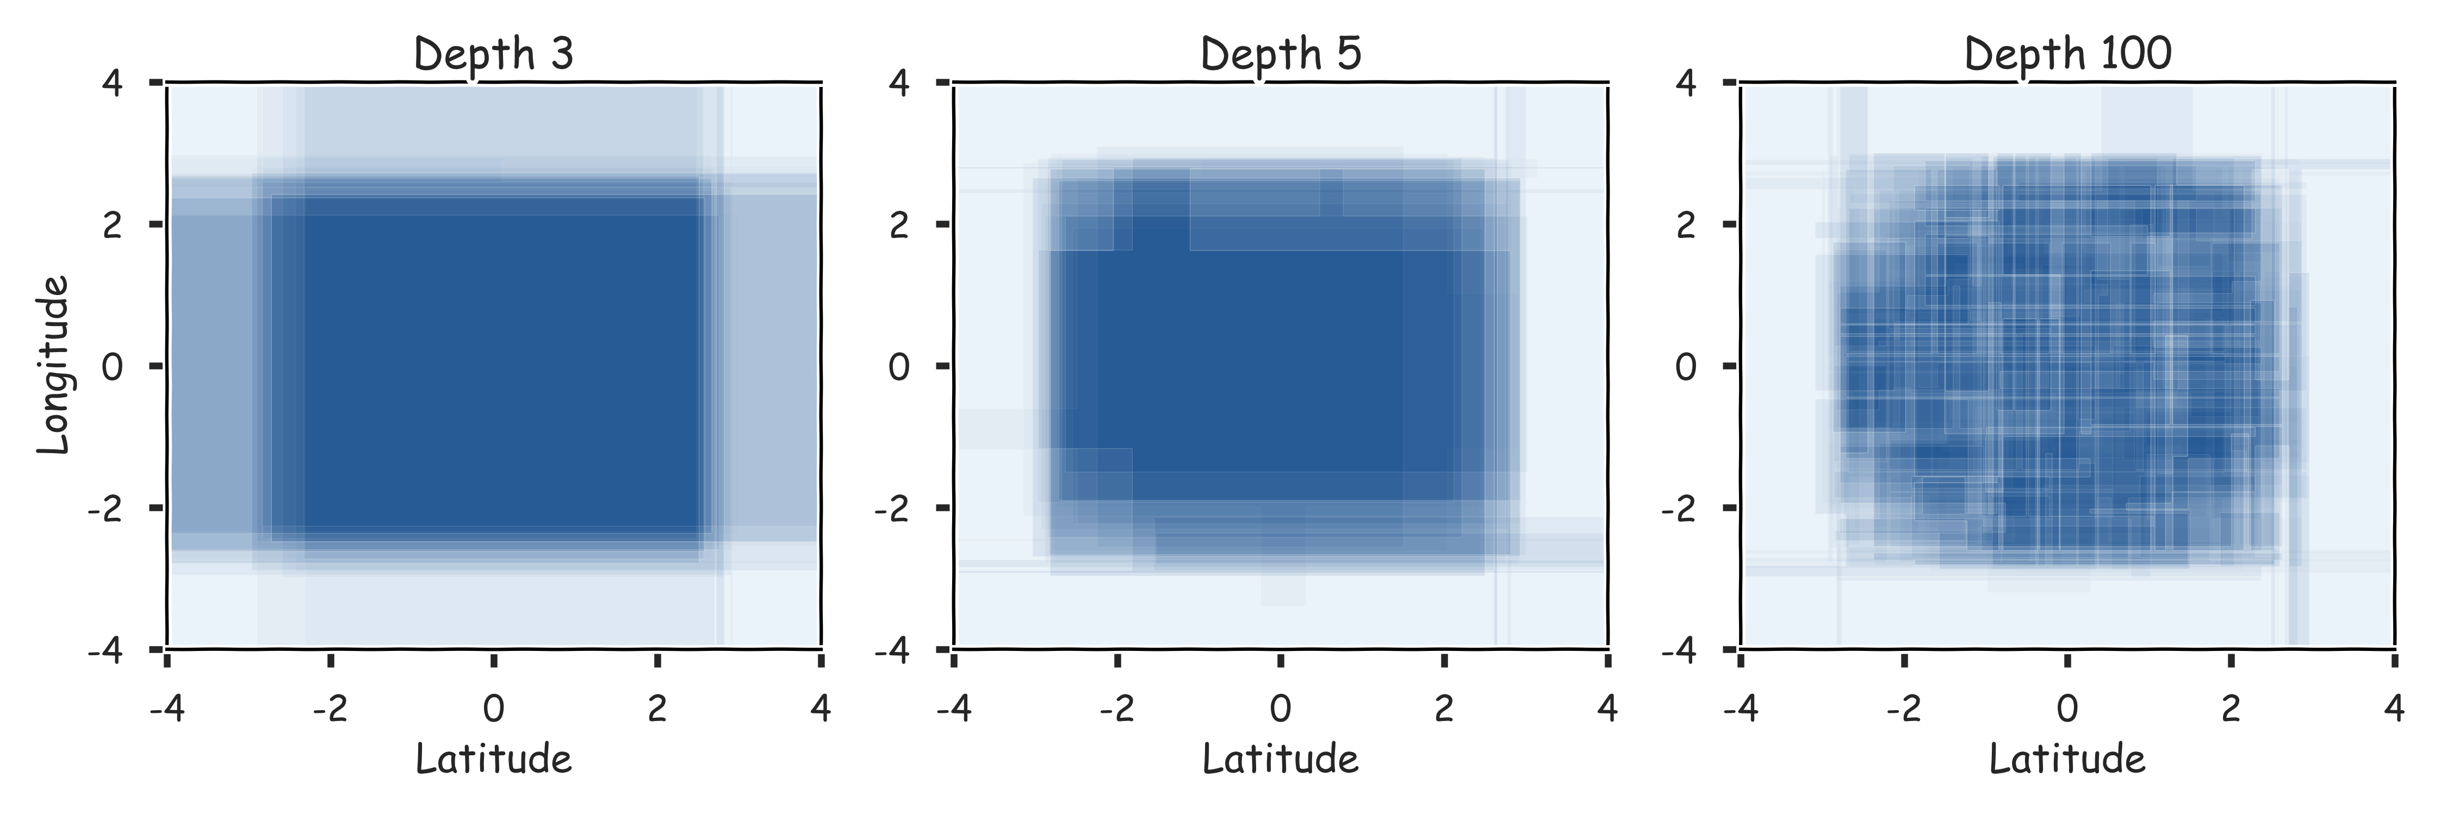
20 magic realisms

Slide 31
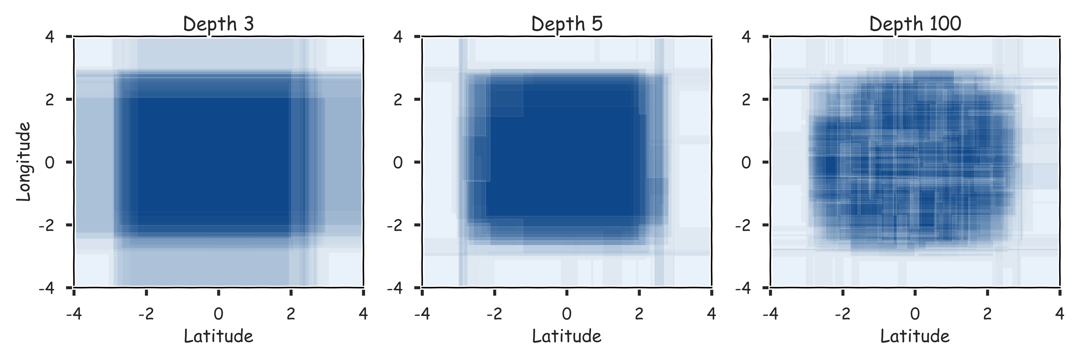
100 magic realisms

Slide 32
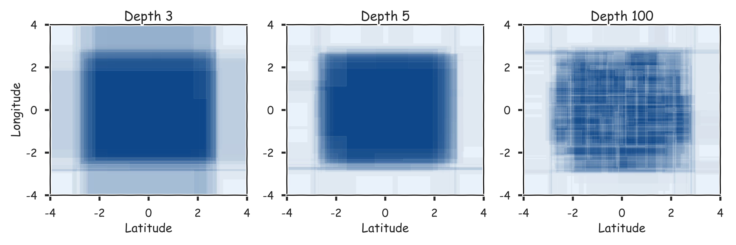
300 magic realisms

Slide 33
Bagging
One way to adjust for the high variance of the output of an experiment is to perform the experiment multiple times and then average the results.
The same idea can be applied to high variance models:
Bootstrap: we generate multiple samples of training data, via bootstrapping. We train a deeper decision tree on each sample of data.
Aggregate: for a given input, we output the averaged outputs of all the models for that input.
This method is called Bagging (Breiman, 1996), short for, of course, Bootstrap Aggregating.
For classification, we return the class that is outputted by the plurality of the models. For regression we return the average of the outputs for each tree.

Slide 34
Bagging
Bagging enjoys the benefits of:
High expressiveness - by using deeper trees each model is able to approximate complex functions and decision boundaries.
Low variance - averaging the prediction of all the models reduces the variance in the final prediction, assuming that we choose a sufficiently large number of trees.

Slide 35
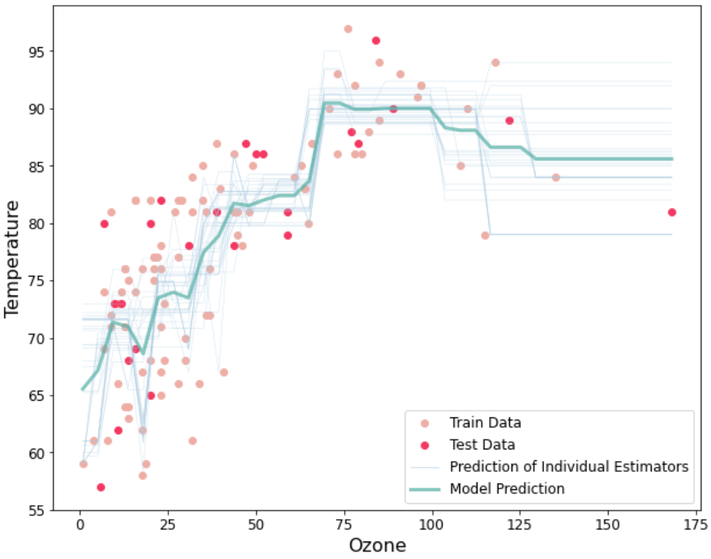
Bagging (regression)
The resulting tree is the average of all tree (estimators).

Slide 36
Bagging (classification)
For each bootstrap, we build a decision tree. The results is a combination (majority) of the predictions from all trees.

Slide 37
Bagging
Question: Do you see any problems?

Slide 38
Bagging
Question: Do you see any problems?
If trees are too shallow it can still underfit.
Still some overfitting if the trees are too large.
Interpretability:
The major drawback of bagging (and other ensemble methods that we will study) is that the averaged model is no longer easily interpretable - i.e. one can no longer trace the ‘logic’ of an output through a series of decisions based on predictor values!

Slide 39
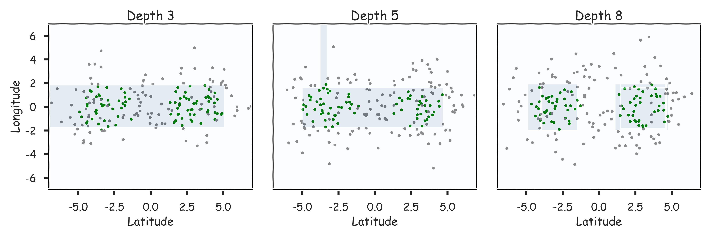
Case of underfitting
Consider the dataset below. To capture the pattern we need deeper tree.

Slide 40
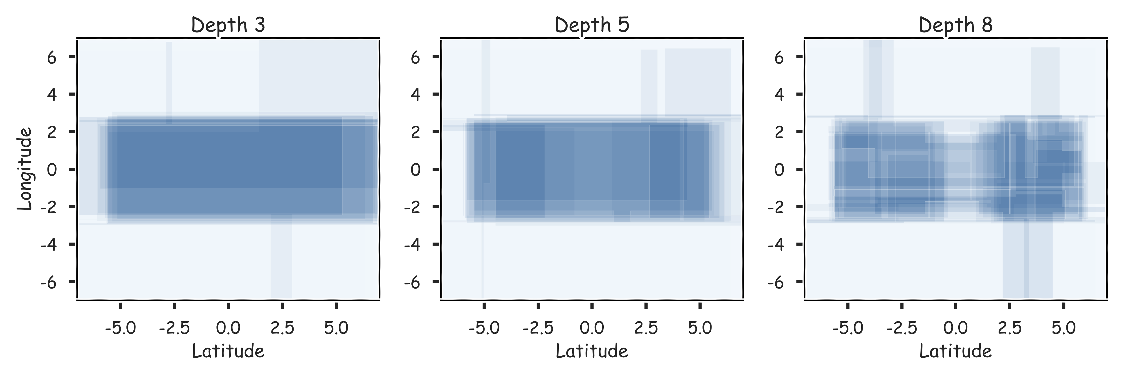
Case of underfitting
Here we fit 100 trees using bootstrapped samples. Even with multiple estimators, the shallow tree will not be able to capture the real pattern.

Slide 41
Bagging
Question: Do you see any problems?
If trees are too shallow it can still underfit.
Still some overfitting if the trees are too large.
Cross Validation

Slide 42
Outline
Review of Decision Trees
Bagging
Out of Bag Error (OOB)
Variable Importance

Slide 43
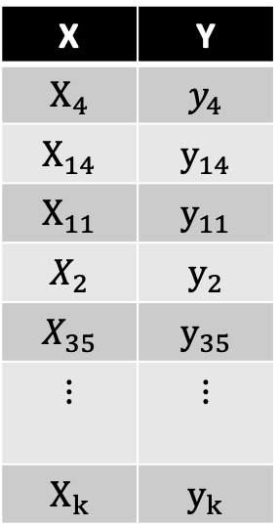
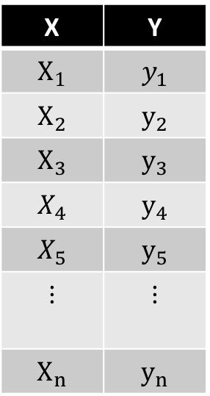
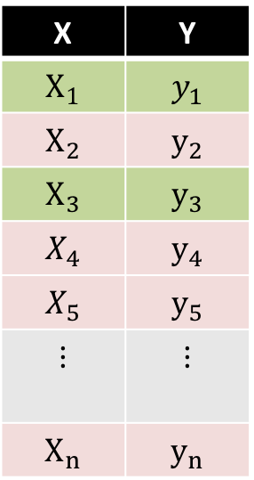
Bagging
Original Data
Bootstrap Sample 1
Decision Tree 1
Used and unused data
X | Y
$$X_{1}$$ | $$y_{1}$$
$$X_{2}$$ | $$y_{2}$$
$$X_{3}$$ | $$y_{3}$$
$$X_{4}$$ | $$y_{4}$$
$$X_{5}$$ | $$y_{5}$$
$$⋮$$ | $$⋮$$
$$X_{n}$$ | $$y_{n}$$
X | Y
$$X_{4}$$ | $$y_{4}$$
$$X_{14}$$ | $$y_{14}$$
$$X_{11}$$ | $$y_{11}$$
$$X_{2}$$ | $$y_{2}$$
$$X_{35}$$ | $$y_{35}$$
$$⋮$$ | $$⋮$$
$$X_{k}$$ | $$y_{k}$$
X | Y
$$X_{1}$$ | $$y_{1}$$
$$X_{2}$$ | $$y_{2}$$
$$X_{3}$$ | $$y_{3}$$
$$X_{4}$$ | $$y_{4}$$
$$X_{5}$$ | $$y_{5}$$
$$⋮$$ | $$⋮$$
$$X_{n}$$ | $$y_{n}$$

Slide 44
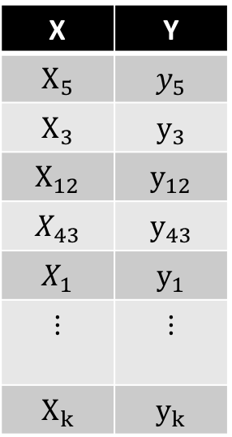
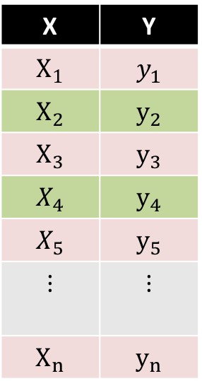
Bagging
Original Data
Bootstrap Sample 2
Decision Tree 2
Used and unused data
X | Y
$$X_{1}$$ | $$y_{1}$$
$$X_{2}$$ | $$y_{2}$$
$$X_{3}$$ | $$y_{3}$$
$$X_{4}$$ | $$y_{4}$$
$$X_{5}$$ | $$y_{5}$$
$$⋮$$ | $$⋮$$
$$X_{n}$$ | $$y_{n}$$
X | Y
$$X_{5}$$ | $$y_{5}$$
$$X_{3}$$ | $$y_{3}$$
$$X_{12}$$ | $$y_{12}$$
$$X_{43}$$ | $$y_{43}$$
$$X_{1}$$ | $$y_{1}$$
$$⋮$$ | $$⋮$$
$$X_{k}$$ | $$y_{k}$$
X | Y
$$X_{1}$$ | $$y_{1}$$
$$X_{2}$$ | $$y_{2}$$
$$X_{3}$$ | $$y_{3}$$
$$X_{4}$$ | $$y_{4}$$
$$X_{5}$$ | $$y_{5}$$
$$⋮$$ | $$⋮$$
$$X_{n}$$ | $$y_{n}$$

Slide 45

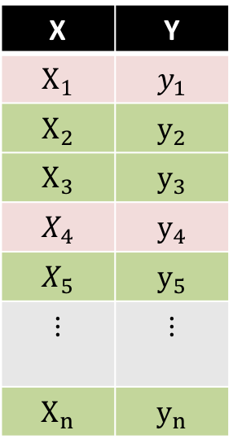
Bagging
Original Data
Bootstrap Sample 3
Decision Tree 3
Used and unused data
X | Y
$$X_{1}$$ | $$y_{1}$$
$$X_{2}$$ | $$y_{2}$$
$$X_{3}$$ | $$y_{3}$$
$$X_{4}$$ | $$y_{4}$$
$$X_{5}$$ | $$y_{5}$$
$$⋮$$ | $$⋮$$
$$X_{n}$$ | $$y_{n}$$
X | Y
$$X_{9}$$ | $$y_{9}$$
$$X_{4}$$ | $$y_{4}$$
$$X_{1}$$ | $$y_{1}$$
$$X_{1}$$ | $$y_{1}$$
$$X_{65}$$ | $$y_{65}$$
$$⋮$$ | $$⋮$$
$$X_{k}$$ | $$y_{k}$$
X | Y
$$X_{1}$$ | $$y_{1}$$
$$X_{2}$$ | $$y_{2}$$
$$X_{3}$$ | $$y_{3}$$
$$X_{4}$$ | $$y_{4}$$
$$X_{5}$$ | $$y_{5}$$
$$⋮$$ | $$⋮$$
$$X_{n}$$ | $$y_{n}$$

Slide 46
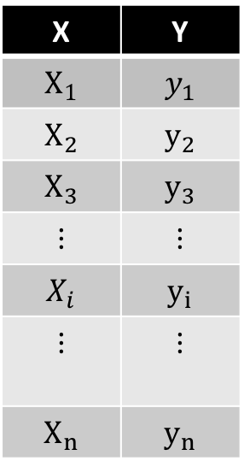
Point-wise out-of-bag error
X | Y
$$X_{1}$$ | $$y_{1}$$
$$X_{2}$$ | $$y_{2}$$
$$X_{3}$$ | $$y_{3}$$
$$⋮$$ | $$⋮$$
$$X_{i}$$ | $$y_{i}$$
$$⋮$$ | $$⋮$$
$$X_{n}$$ | $$y_{n}$$

Slide 47
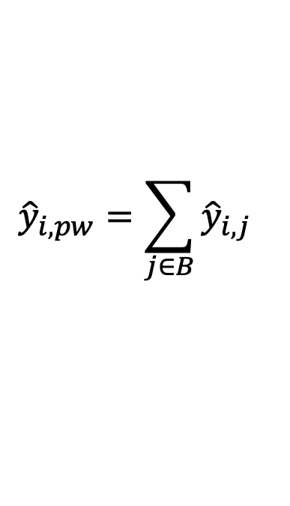
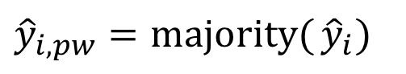
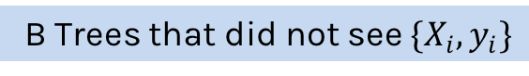
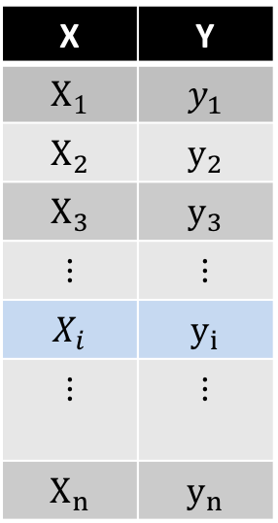
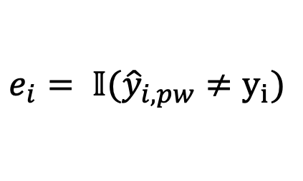
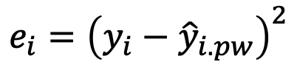
Point-wise out-of-bag error
B Trees that did not see $\{X_{i},y_{i}\}$
X | Y
$$X_{1}$$ | $$y_{1}$$
$$X_{2}$$ | $$y_{2}$$
$$X_{3}$$ | $$y_{3}$$
$$⋮$$ | $$⋮$$
$$X_{i}$$ | $$y_{i}$$
$$⋮$$ | $$⋮$$
$$X_{n}$$ | $$y_{n}$$
Classification
$${\hat{y}}_{i,pw}=majority({{\hat{y}}_{i})}$$
$$e_{i}= 𝕀({\hat{y}}_{i,pw}≠y_{i})$$
Regression
$${\hat{y}}_{i,pw}=\sum_{j∈B}{{\hat{y}}_{i,j}}$$
$$e_{i}={\left(y_{i}−{\hat{y}}_{i.pw}\right)}^{2}$$

Slide 48
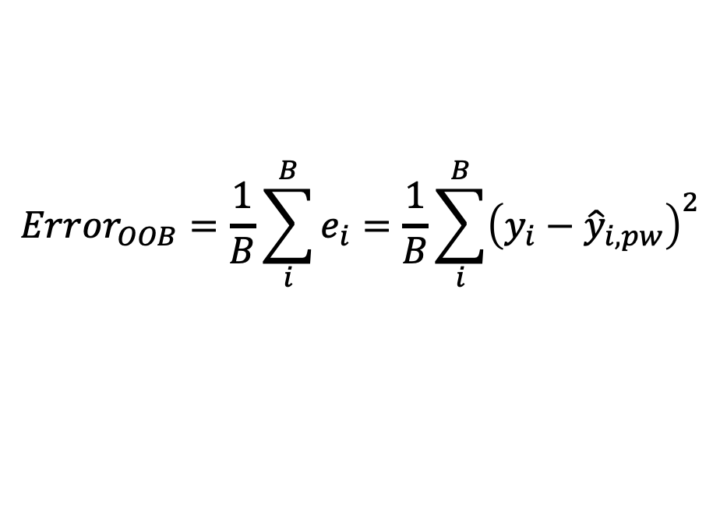
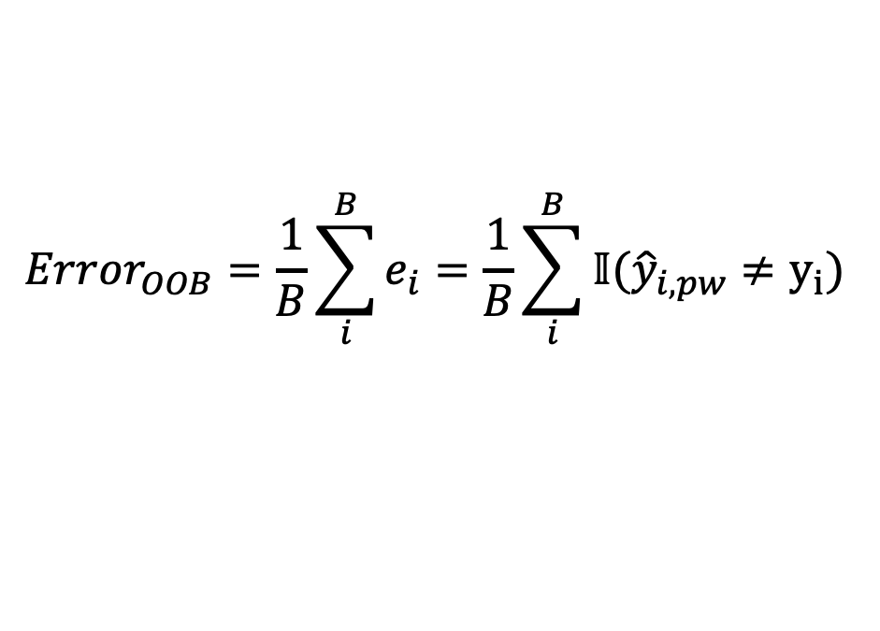
OOB Error
We average the point-wise out-of-bag error over the full training set.
Classification
$$Error_{OOB}=\frac{1}{B}\sum_{i}^{B}{e_{i}}=\frac{1}{B}\sum_{i}^{B}{𝕀({\hat{y}}_{i,pw}≠y_{i}) }$$
Regression
$$Error_{OOB}=\frac{1}{B}\sum_{i}^{B}{e_{i}}=\frac{1}{B}\sum_{i}^{B}{{\left(y_{i}−{\hat{y}}_{i,pw}\right)}^{2}}$$

Slide 49
Out-of-Bag Error
Bagging is an example of an ensemble method, a method of building a single model by training and aggregating multiple models.
With ensemble methods, we get a new metric for assessing the predictive performance of the model, the out-of-bag error.
Given a training set and an ensemble of models, each trained on a bootstrap sample, we compute the out-of-bag error of the averaged model by
For each point in the training set, we average the predicted output for this point over the models whose bootstrap training set excludes this point. We compute the error or squared error of this averaged prediction. Call this the point-wise out-of-bag error.
We average the point-wise out-of-bag error over the full training set.

Slide 50
Bagging
Question: Do you see any problems?
If trees are too shallow it can still underfit.
Still some overfitting if the trees are too large.
Interpretability:
The major drawback of bagging (and other ensemble methods that we will study) is that the averaged model is no longer easily interpretable - i.e. one can no longer trace the ‘logic’ of an output through a series of decisions based on predictor values!

Slide 51
Outline
Review of Decision Trees
Bagging
Out of Bag Error (OOB)
Variable Importance

Slide 52
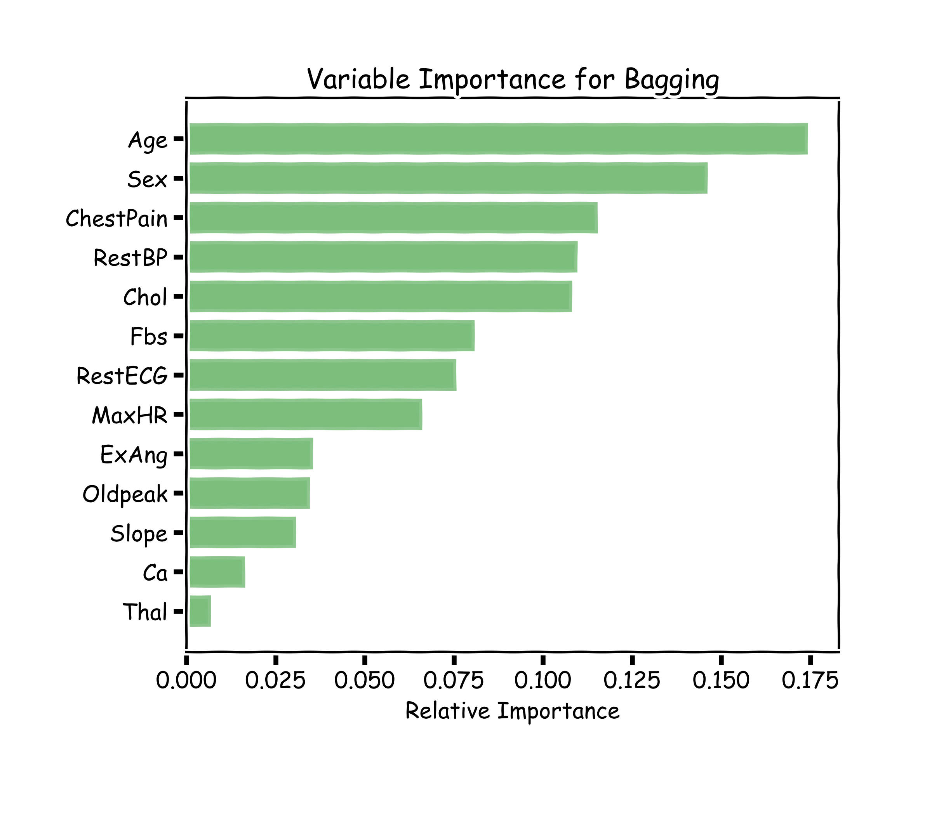
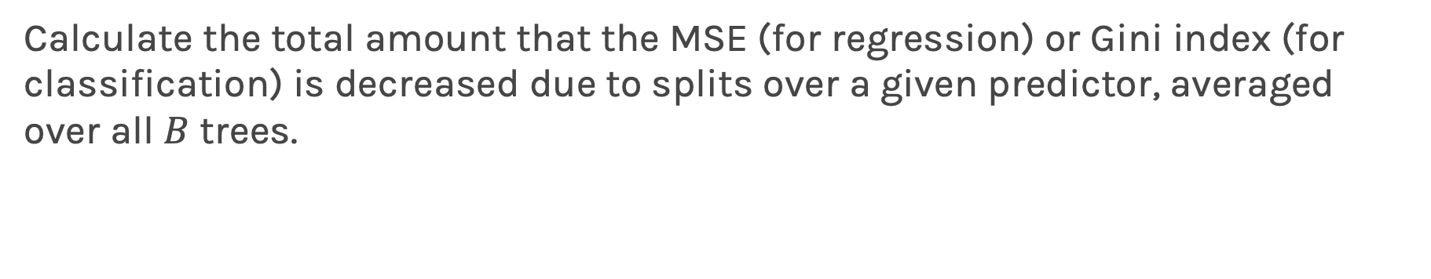
Variable Importance for Bagging
Calculate the total amount that the MSE (for regression) or Gini index (for classification) is decreased due to splits over a given predictor, averaged over all $B$ trees.
100 trees, max_depth=10

Slide 53
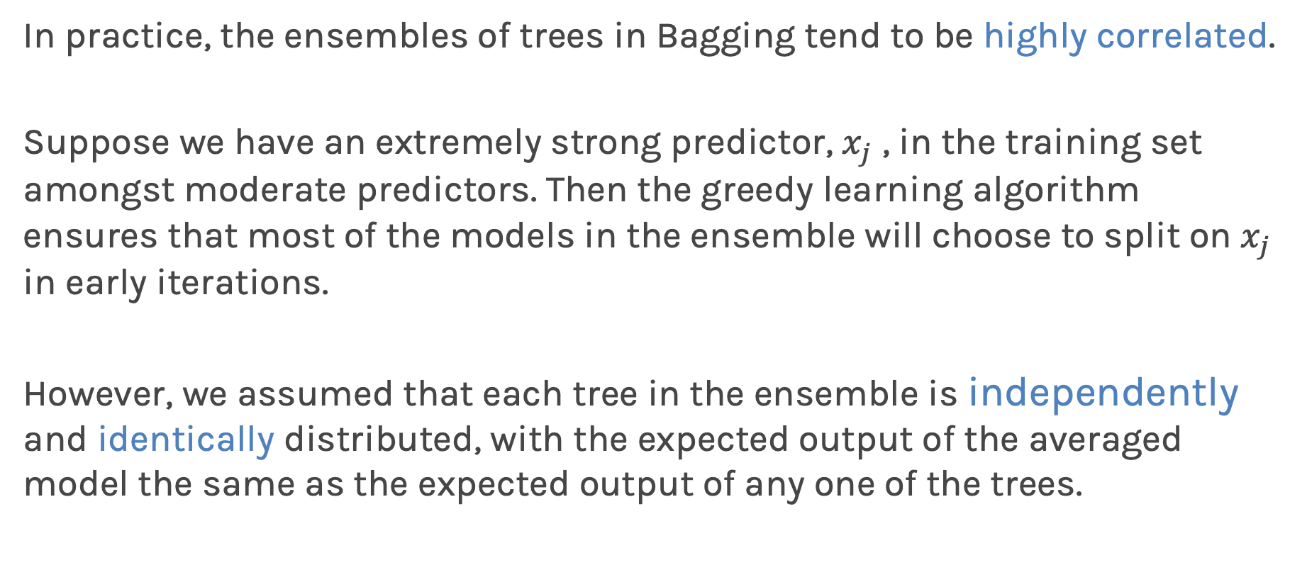
Improving on Bagging
In practice, the ensembles of trees in Bagging tend to be highly correlated.
Suppose we have an extremely strong predictor, $x_{j}$ , in the training set amongst moderate predictors. Then the greedy learning algorithm ensures that most of the models in the ensemble will choose to split on $x_{j}$ in early iterations.
However, we assumed that each tree in the ensemble is independently and identically distributed, with the expected output of the averaged model the same as the expected output of any one of the trees.

Slide 54
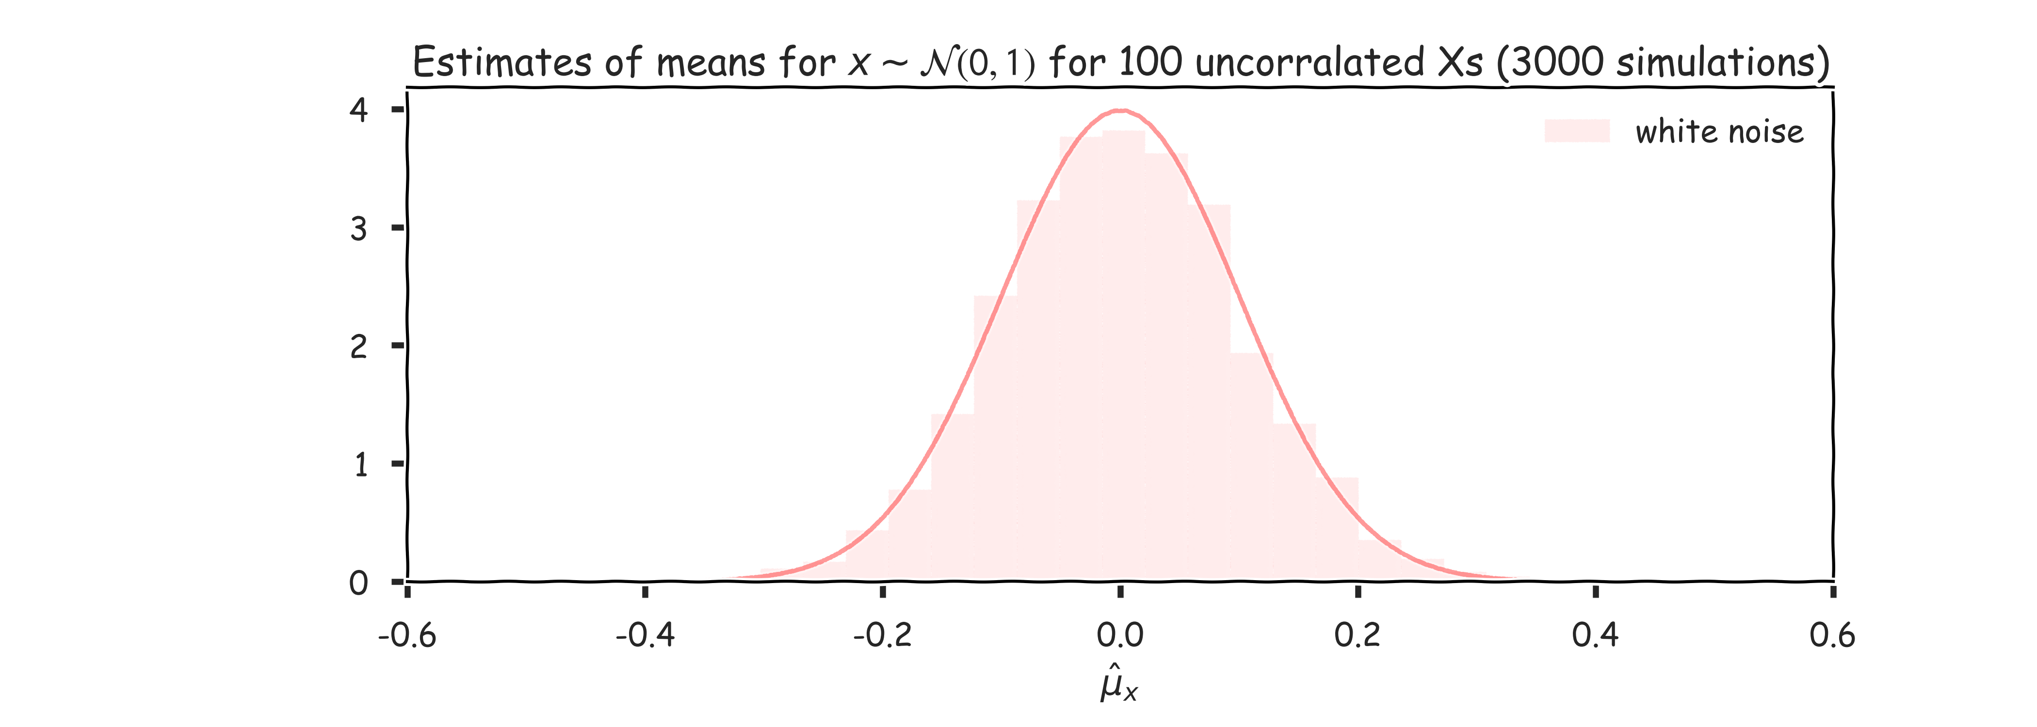
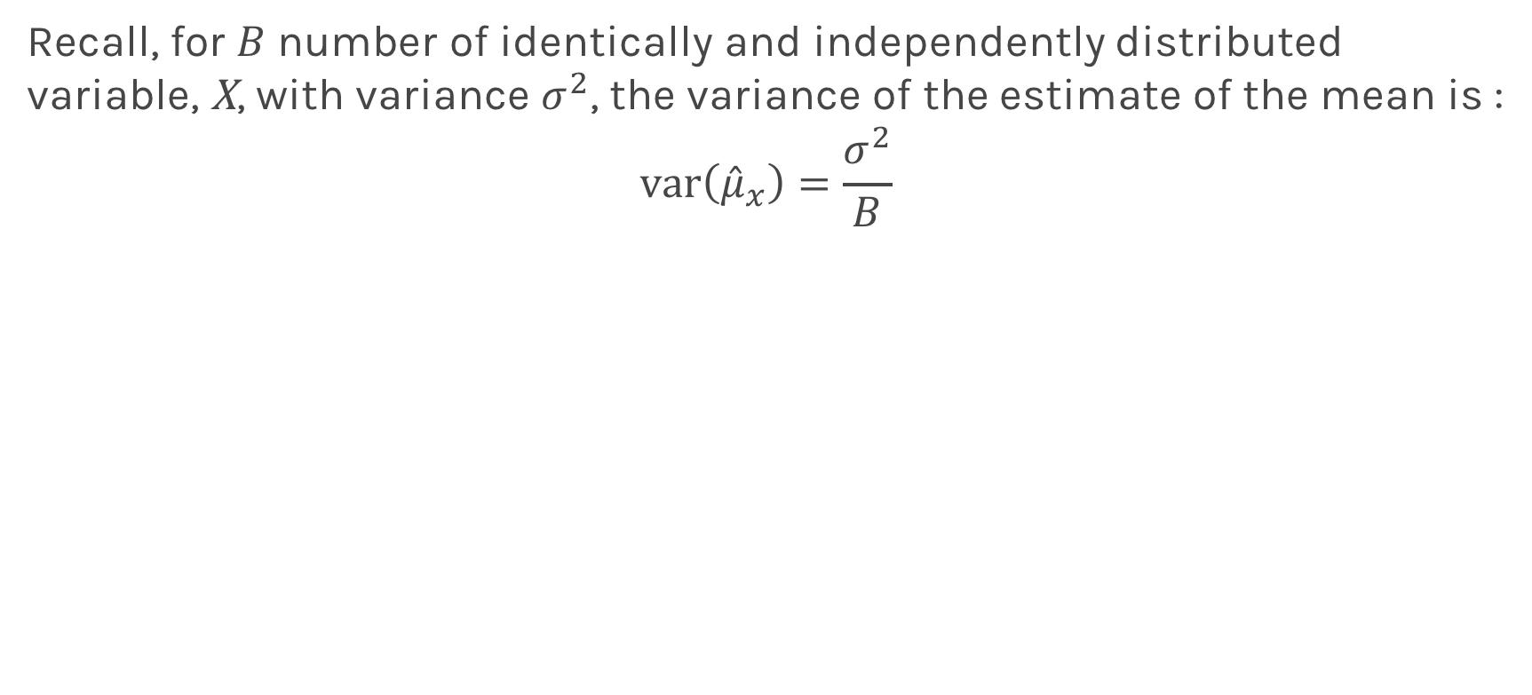
Improving on Bagging
Recall, for $B$ number of identically and independently distributed variable, X, with variance $σ^{2}$, the variance of the estimate of the mean is :
$$var\left({\hat{μ}}_{x}\right)=\frac{σ^{2}}{B}$$

Slide 55
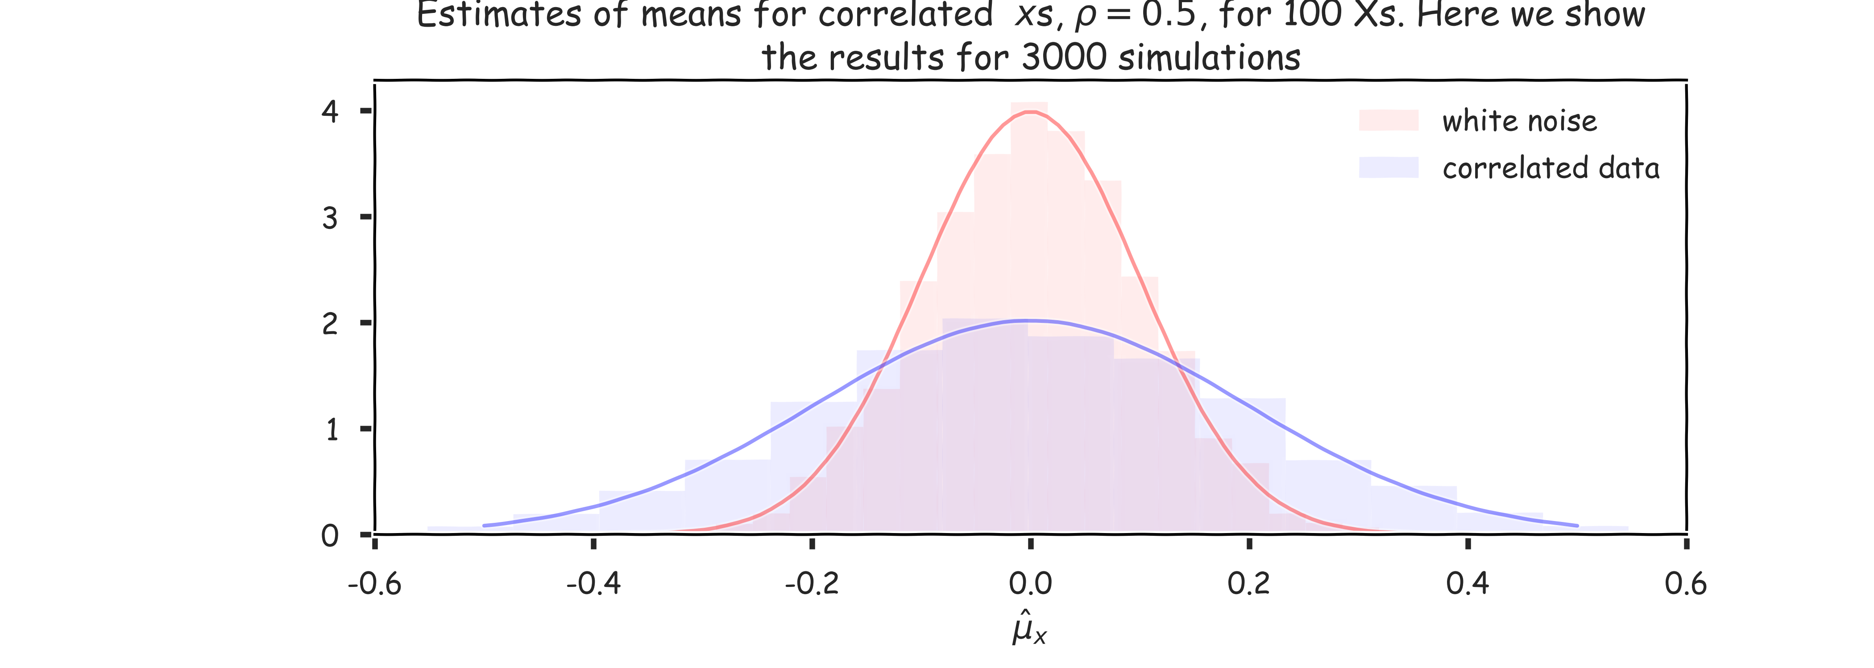
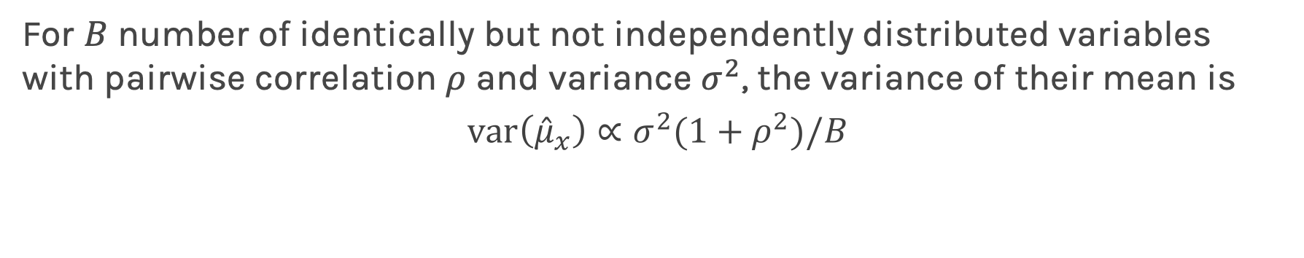
Improving on Bagging
For $B$ number of identically but not independently distributed variables with pairwise correlation $ρ$ and variance $σ^{2}$, the variance of their mean is
$$var\left({\hat{μ}}_{x}\right)∝σ^{2}(1+ρ^{2})/B$$

Slide 56
Another cliff hanger in CS109A

Slide 57
What to do? 🤔
Today’s lucky student: The most charming student in the breakout room
Instructions (a reminder):
Listen to your peers' opinions and suggestions. Ask questions of each other ("What do you think"). Do not just lead others in the room without including everyone.
Make sure you do not cut-off or ignore what other students are trying to contribute.
If you have questions, please reach out to the teaching staff. You can buzz us to come help, or if all else fails, come to the main room.

